Slide 1
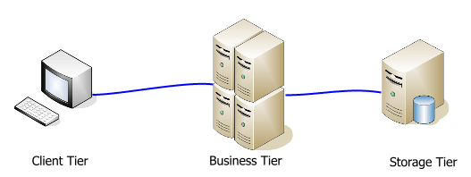
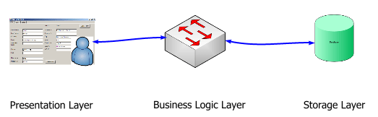
Tiers
vs.
Layers

Slide 2
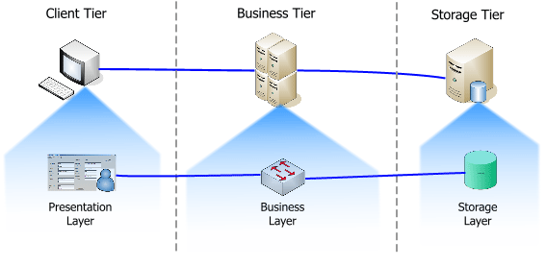
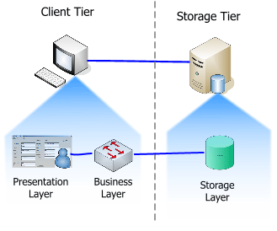
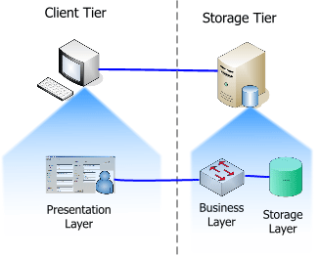

Slide 3

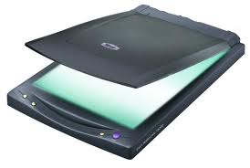

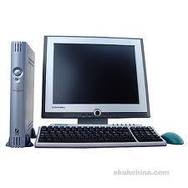

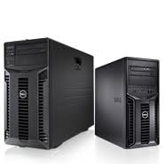
Client Server Model
Every information system involves three main functions:
Data storage and access methods
Application programs to handle the processing logic
Interface that allows users to interact with the system.
What is single-tier Architecture
LAN allows sharing of data and hardware, such as printer and scanners
scanner
Printer
LAN
Client
Server
Client
Client

Slide 4
What is Client/Server Architecture?
Client
is a device that requests and receives information on the network.
The client requests information from server.
It presents and manages the user-interface through application program and data manipulation functions.
It interprets the results send by server and presents the result to user.
Server
Is a computer that provides shared resources to network users.
A server is a process – not machine.
It receives queries or requests from client, interprets and executes the queries and sends the results of queries to the relevant clients.
Server records a transaction.
Client requests information from the server
CLIENT
Server transmits the results and query to the client
SERVER
CLIENT

Slide 5

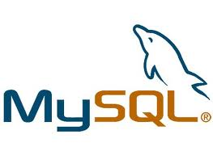


Types of Server?
Client requests data file
Server transmits entire file
File server
client
Client transmits SQL command
Database server
Server transmits results of SQL execution
client
Client triggers transaction
Transaction server
Server executes set of SQL commands and
verifies result
client
Client transmits internet communication
Server transmits internet communication
Web server
client
Client request print documents
Server accepts print job and send to printer
Print server
client

Slide 6
